Slide 1

2017 EFDRR Open Forum Istanbul, Turkey 26-28 March 2017
Technical Session 2: Land-use planning and management practices at the local level
All-hazards vulnerability and impact assessment for multi-level land use planning and management: the Italian case study between gaps and opportunities
A joint presentation by
prof. Giulio Zuccaro, Università di Napoli Federico II, PLINIVS-LUPT Study Centre
Centre of Competence of Italian Department of Civil Protection, Coordinator ESPREssO Project.
prof. Giuseppe Guarino, Municipality of Viggiano
General Director Protezione Civile “Gruppo Lucano”, HIA Committee.
Istanbul, 26.03.2017

Slide 2

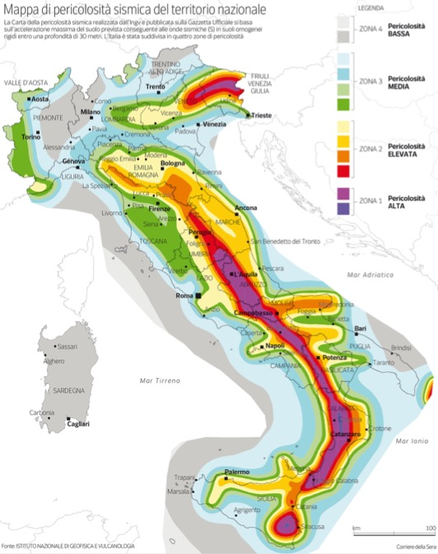
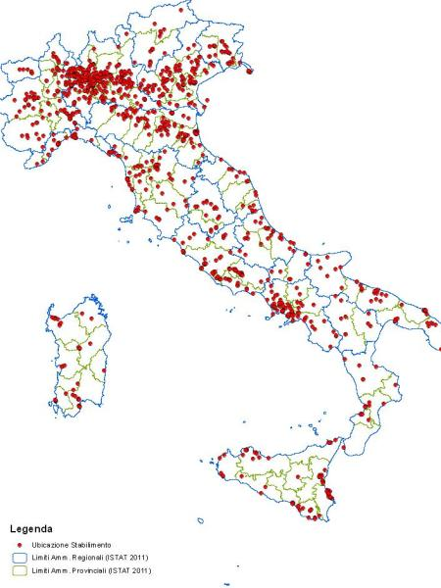
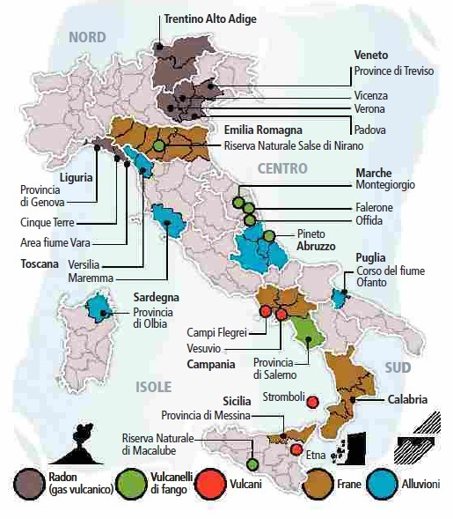
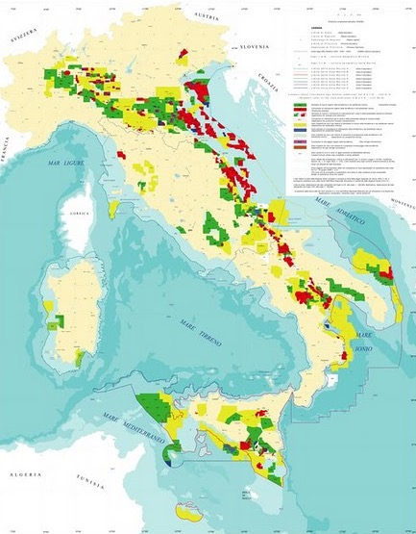
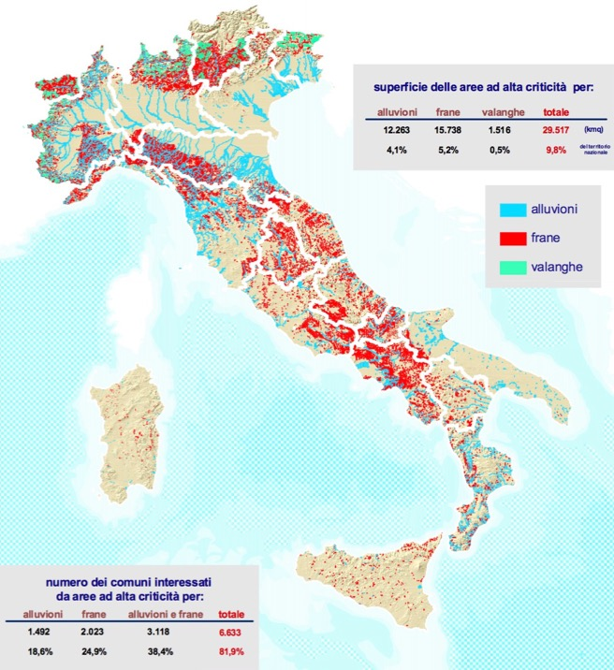
Significance of the Italian case study: Natural, Technological and Natech hazards
SEISMIC HAZARD
INDUSTRIAL HAZARD
VOLCANIC HAZARD
floods
landslides
avalanches
HYDROGEOLOGICAL HAZARD
MINING/OIL EXTRACTION HAZARD

Slide 3
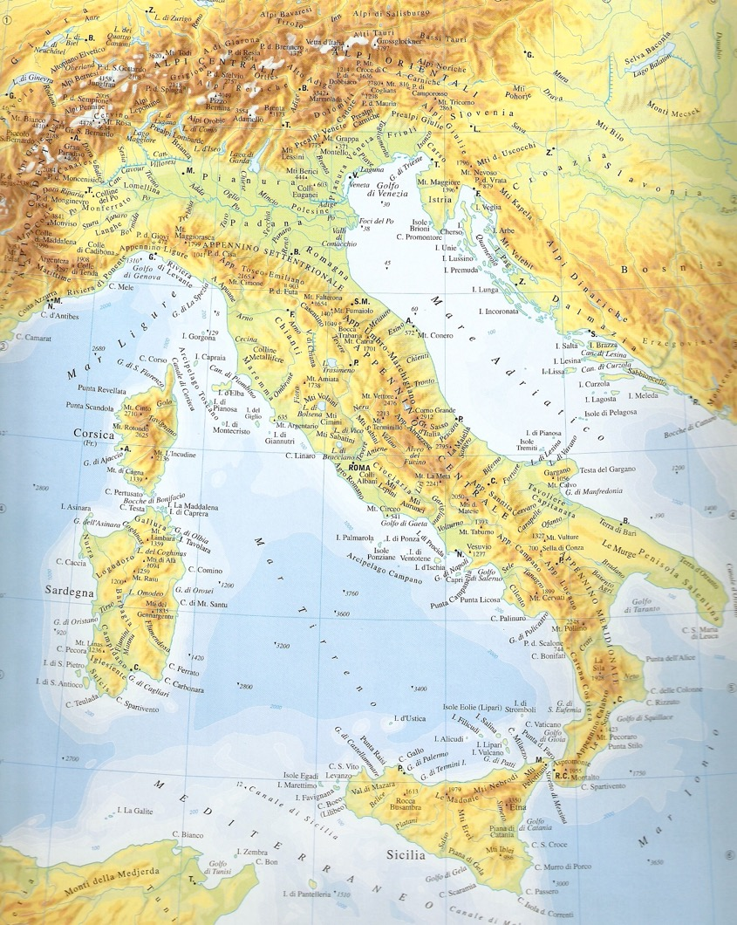

Significance of the Italian case study: Natural, Technological and Natech hazards
  “Well-known” cases
  e.g. Vesuvius, Seveso, L’Aquila/Centre Italy
  Characterized by documented huge impacts and attention from scientists and decision-makers, around which a consistent research background and supporting tools development has been implemented in the last decades.
SEVESO
L’AQUILA
CENTRAL ITALY
PUGLIA
VESUVIUS
  “Almost unknown” cases
  e.g. Natech in Val d’Agri, droughts in south Italy
  Whose actual/potential impacts are underestimated, around which significant community resilience experiences have been built, not only at local level.
VAL D’AGRI

Slide 4
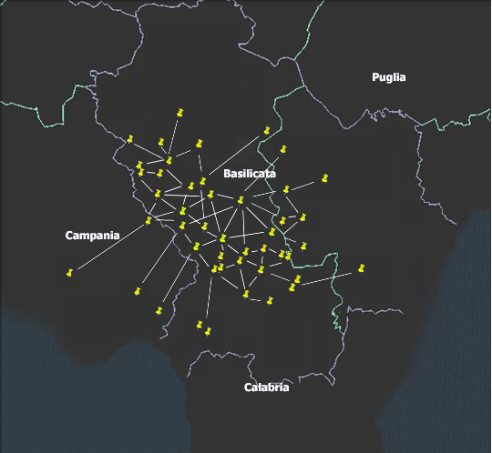
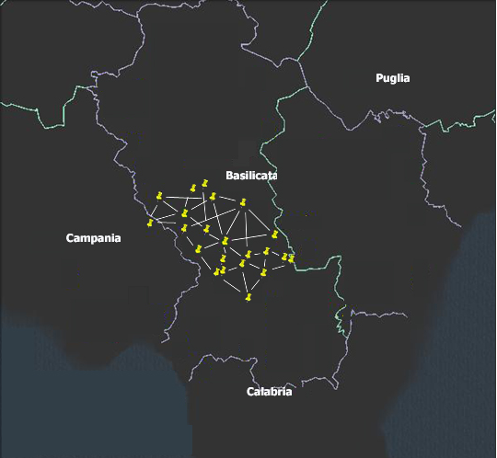
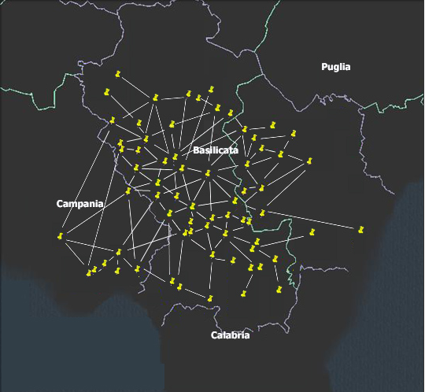
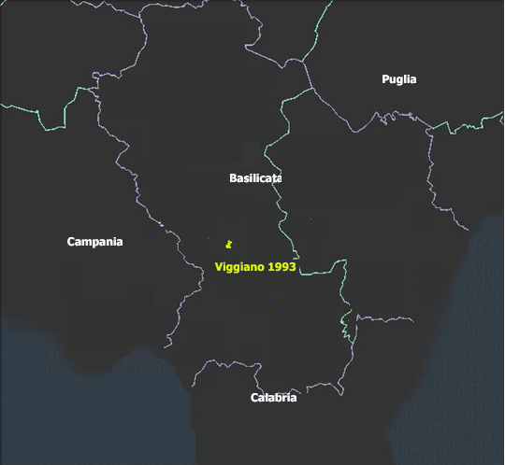
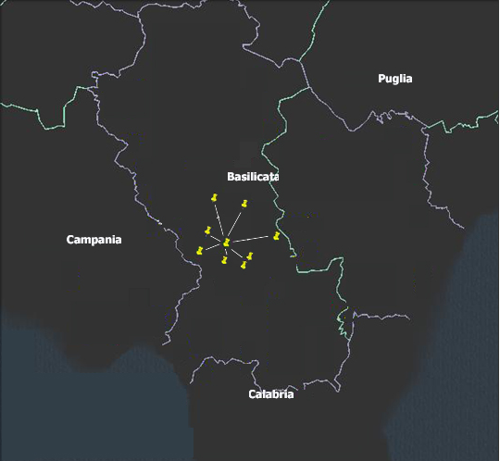
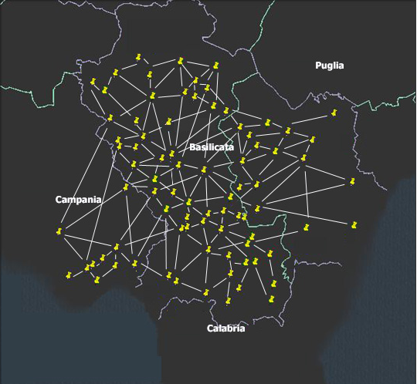
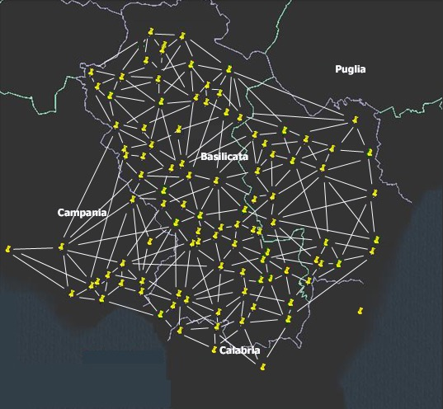
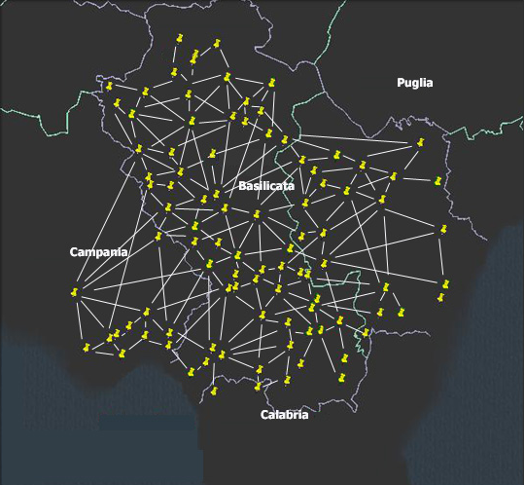




Community resilience in Val D’Agri: Gruppo Lucano and Robert Mallet Foundation
Lucania region is a geographical area that includes Basilicata, Southern Campania and North Calabria
200 small and very small communities
1,000,000 inhabitants
Community resilience has allowed creating critical mass and social cohesion
Sense of solidarity (Volunteering and human capital)
Community
Local institutions
Viggiano is part of the UNISDR Making Cities Resilient Campaign since 2012
Diga di Monte Cotugno
Gruppo Lucano network expansion since 1993.
Gruppo Lucano experiences in Viggiano/Val d’Agri are an example of community resilience and organisational capability: civil protection + scientific division + communication and education
Their need is to activate specific studies to sensitize decision-makers, so to have access to technical and financial resources to program long-term action for territorial governance and resilience-based planning.

Slide 5



PLINIVS Study Centre
for Hydrogeological, Volcanic and Seismic Engineering
National Competence Centre for Italian Civil Protection Department
Interdepartmental Centre of Research
Laboratory of Urban and Territorial Planning
Raffaele d’Ambrosio (LUPT)
University of Naples Federico II, ITALY
www.plinivs.it
The capabilities offered by models and tool developed by PLINIVS within national/EU projects and consultancy activities as Center of Competence of Italian Department of Civil Protection show the importance of impact scenarios (including cascading effects), customized upon the key criticalities at local level (including specific vulnerability analyses and socio-economic aspects)

Slide 6
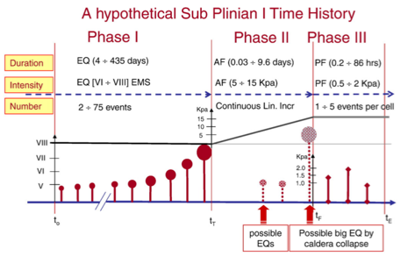
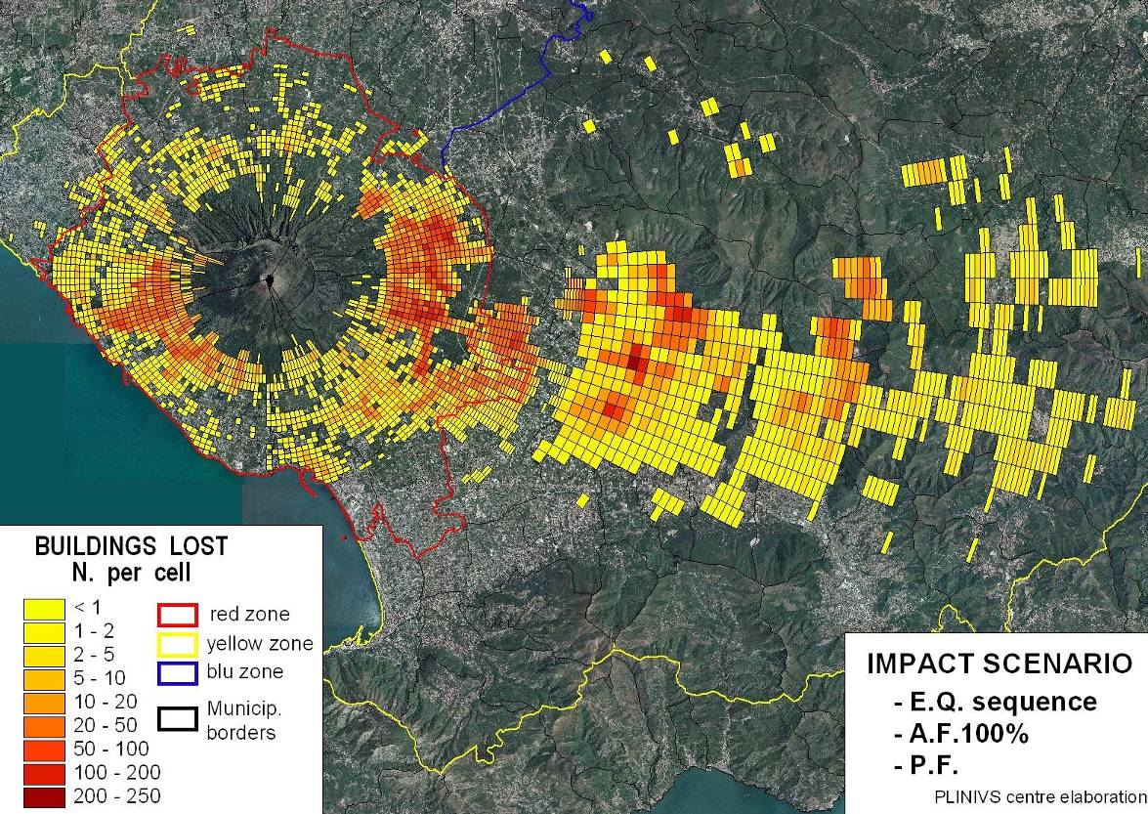
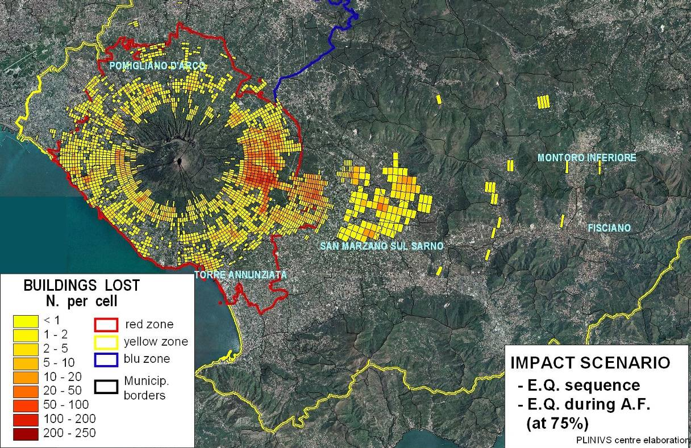
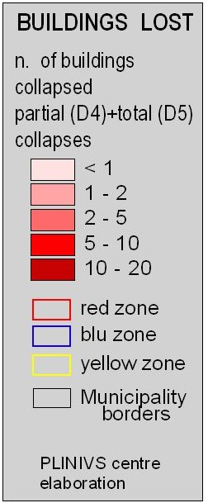
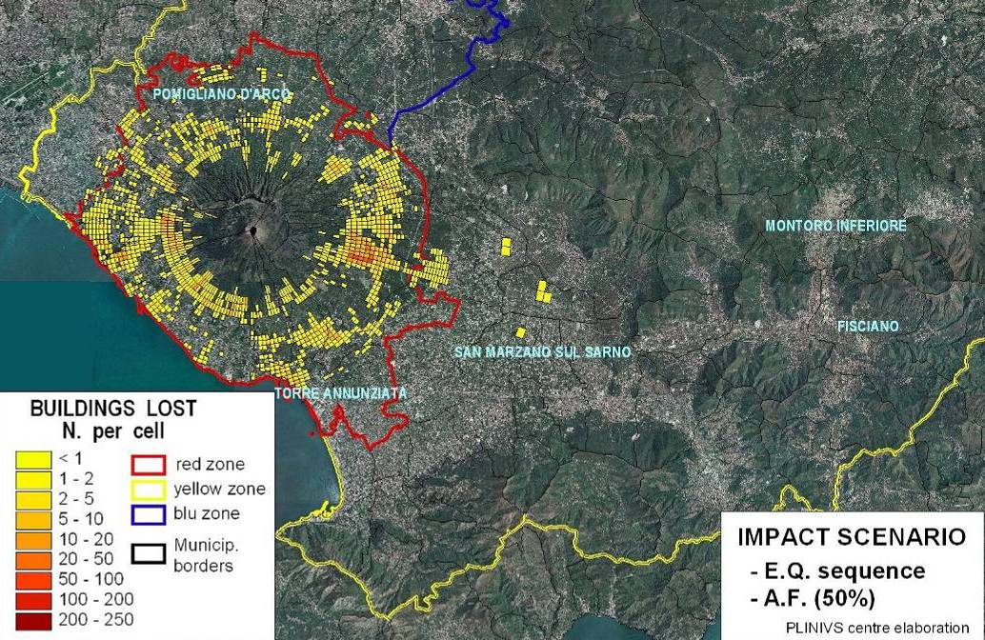
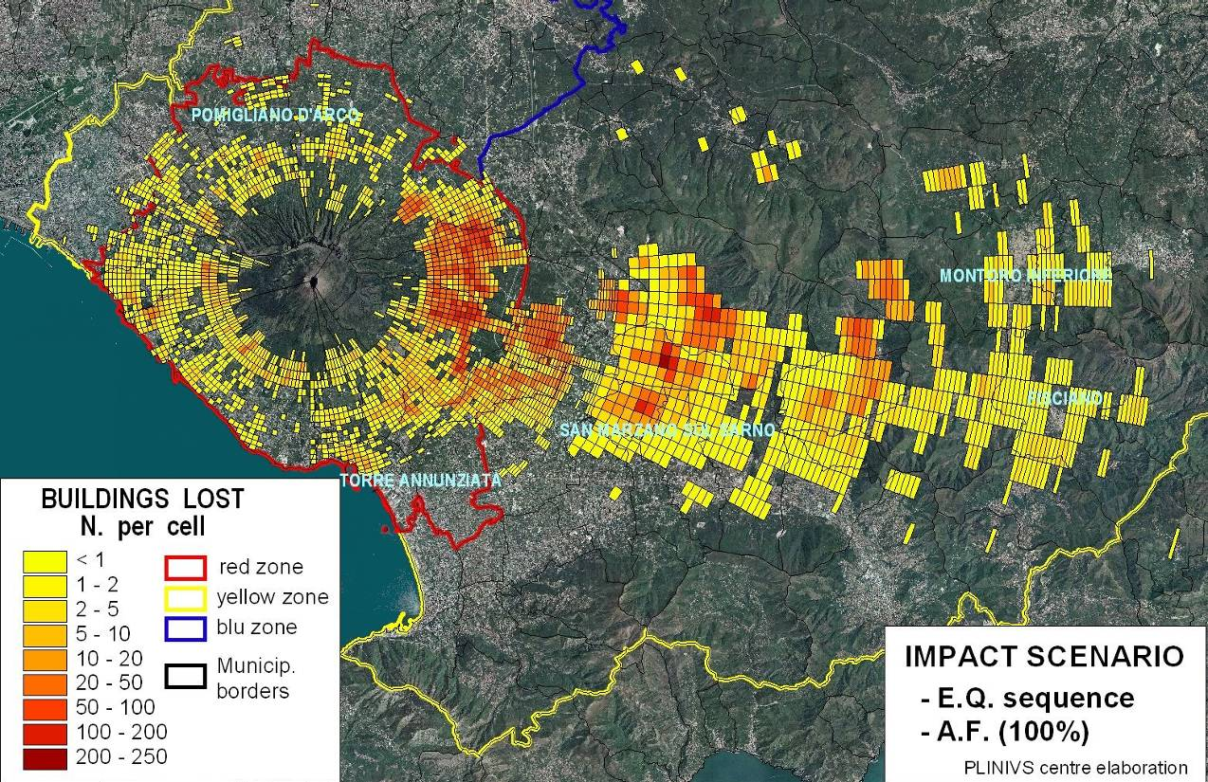
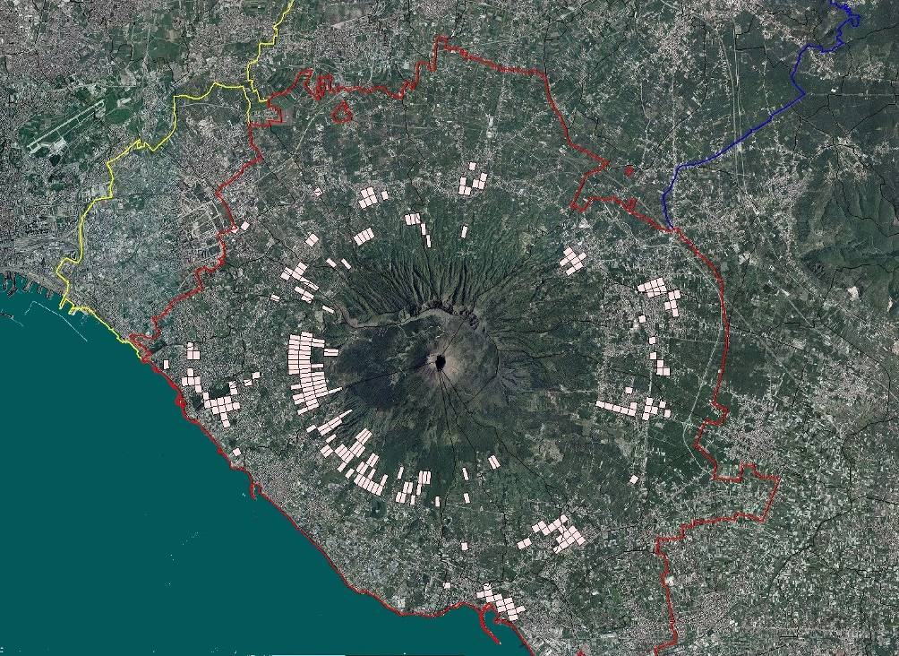
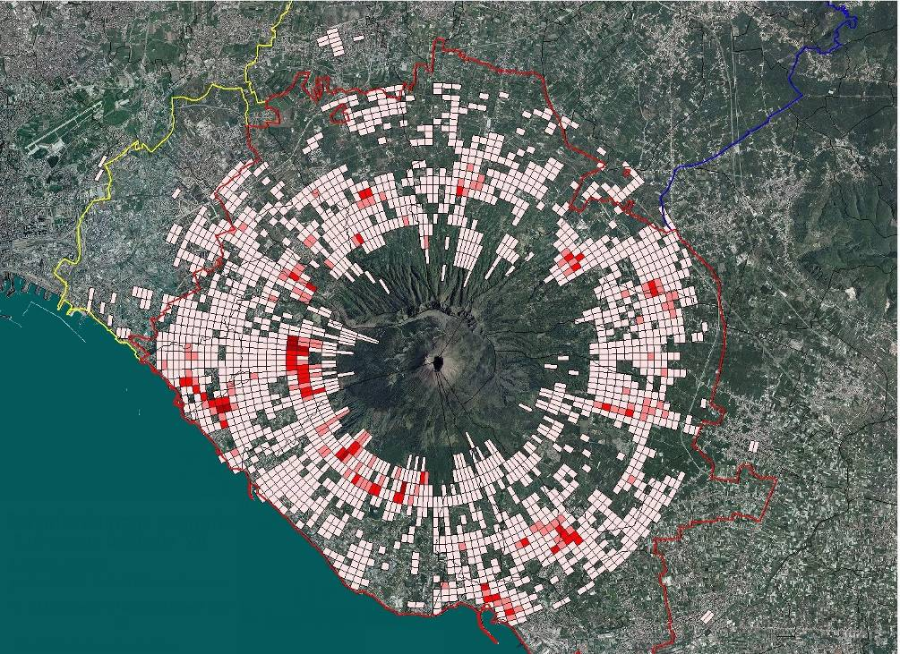
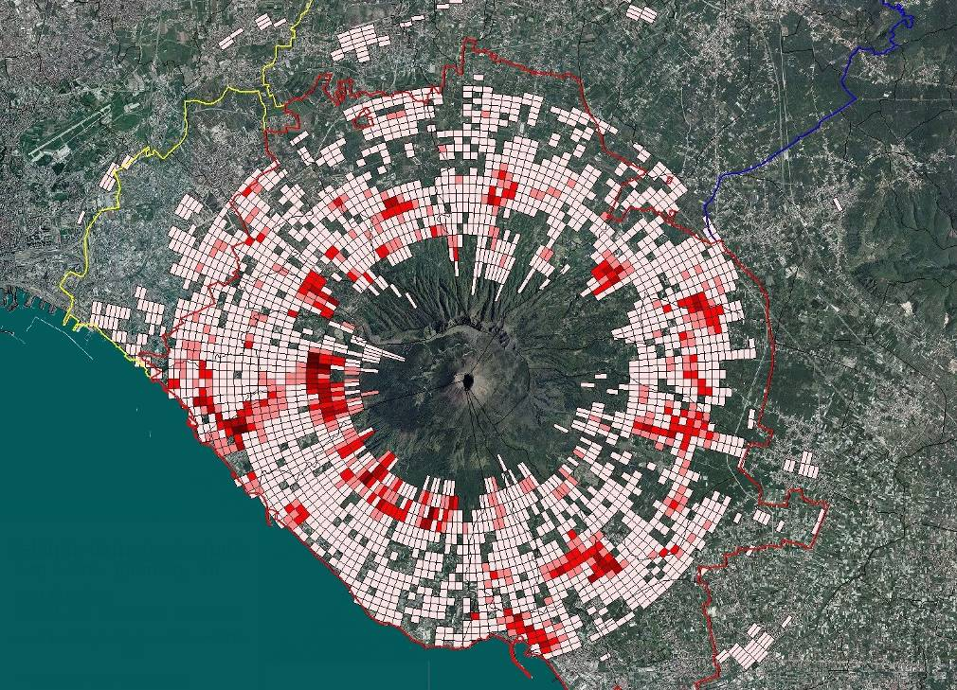
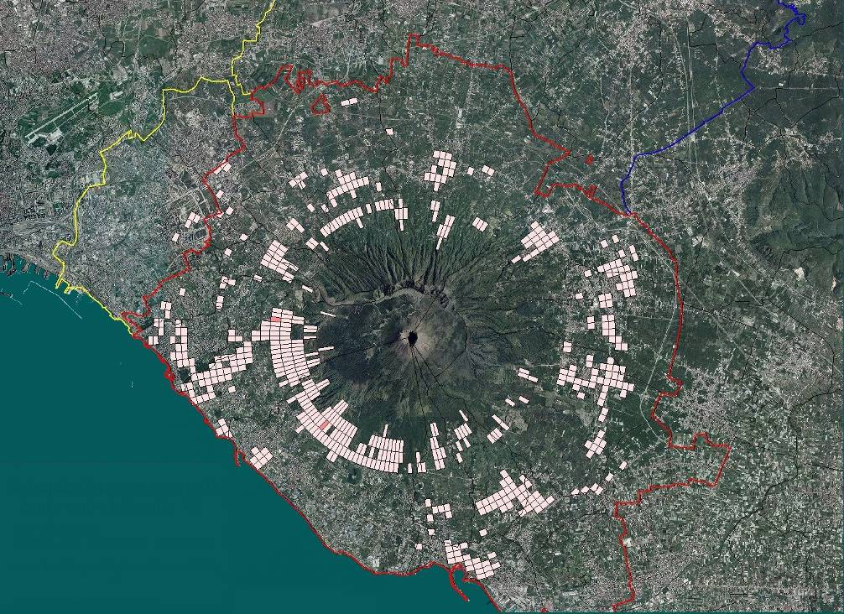
PLINIVS tools – volcanic impact simulation (Vesuvius case)
AF+PF
AF+EQ
AF
EQ

Slide 7
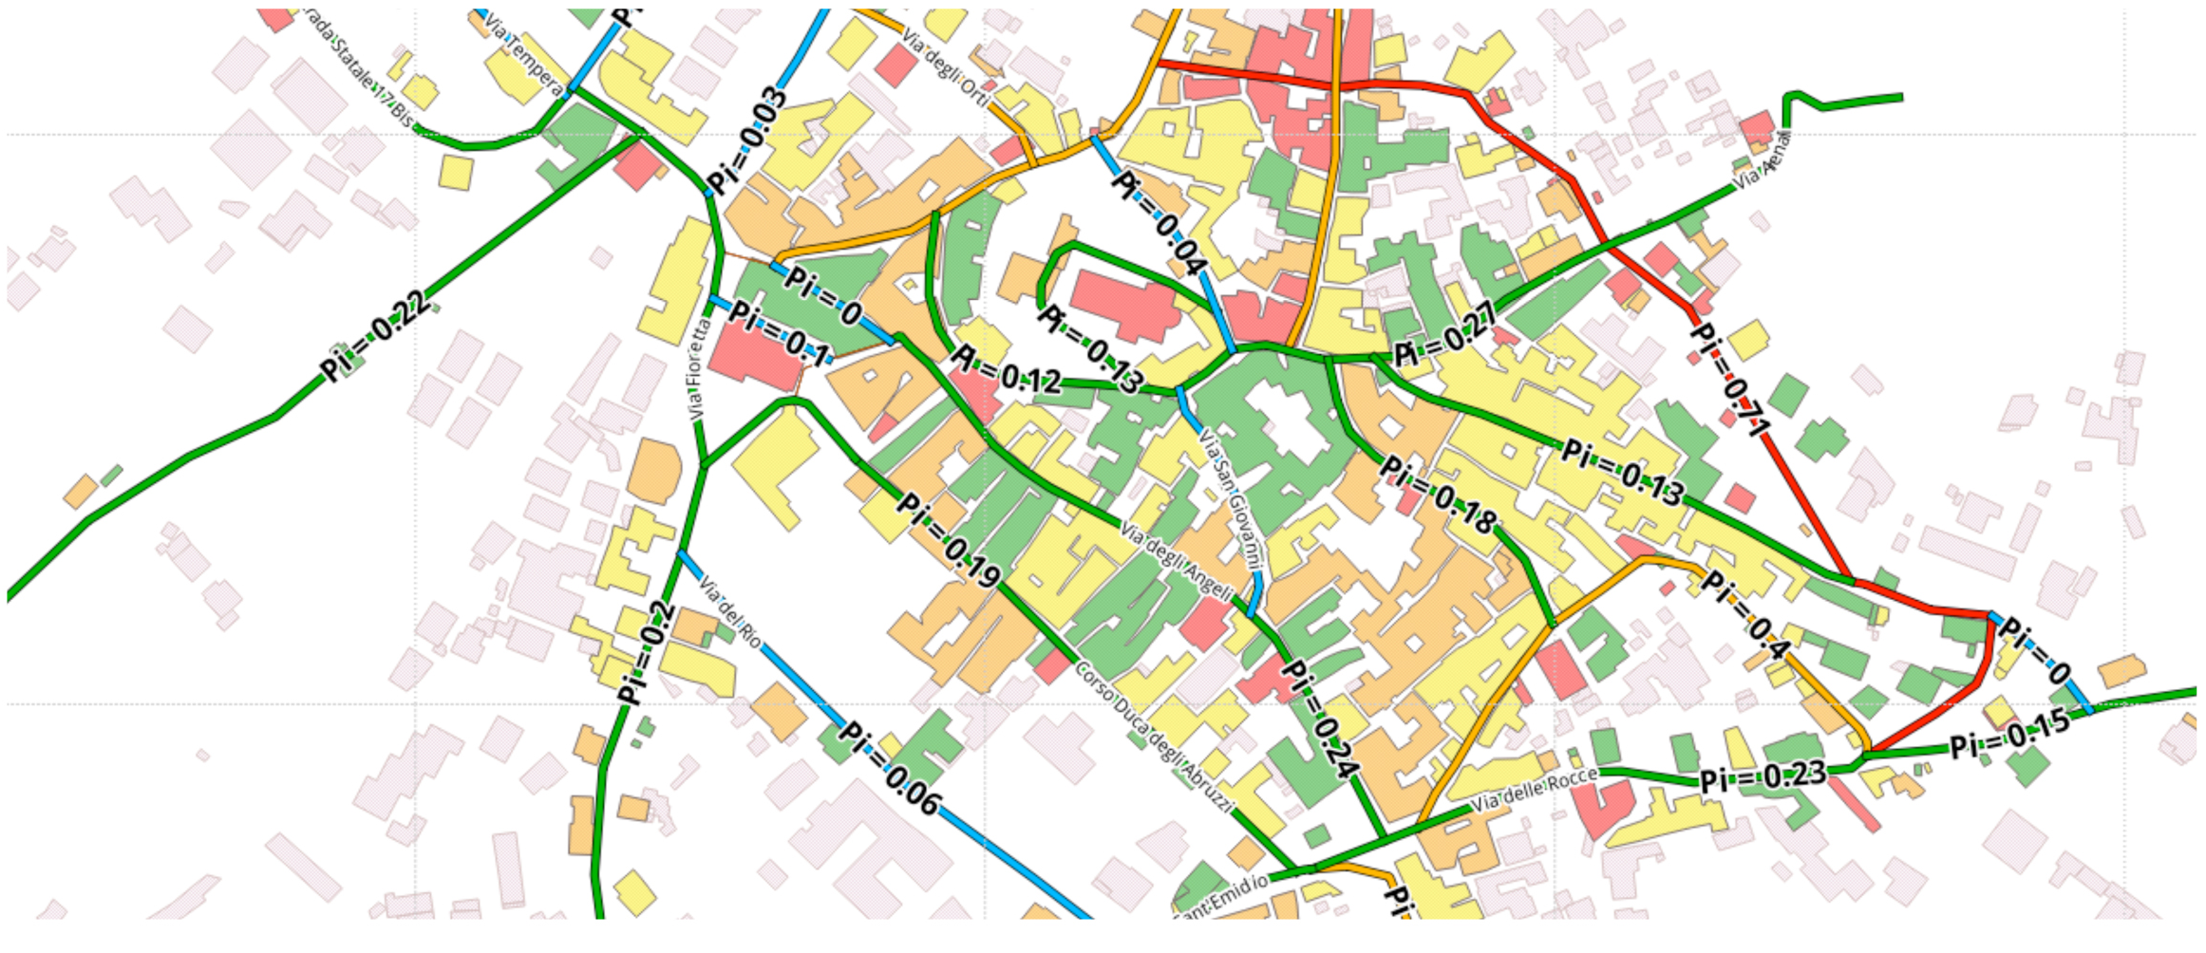
PLINIVS tools – volcanic impact simulation (Vesuvius case)
Seismic impact on escape routes and node links (unrest phase).

Slide 8
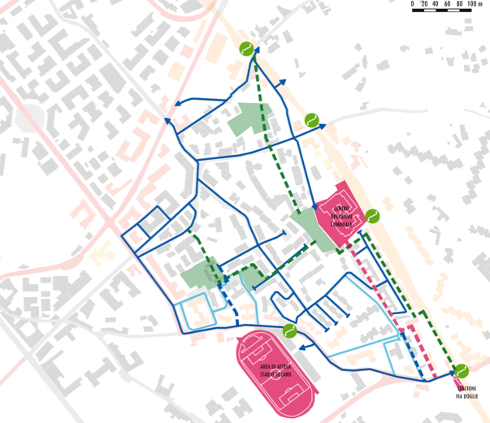
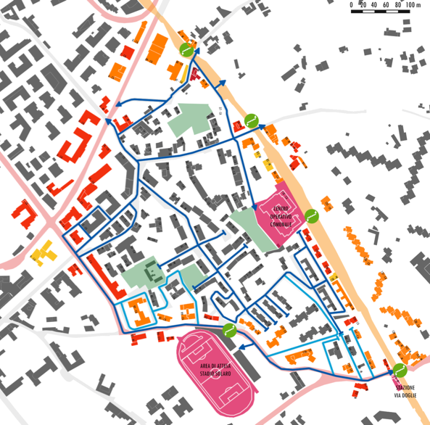
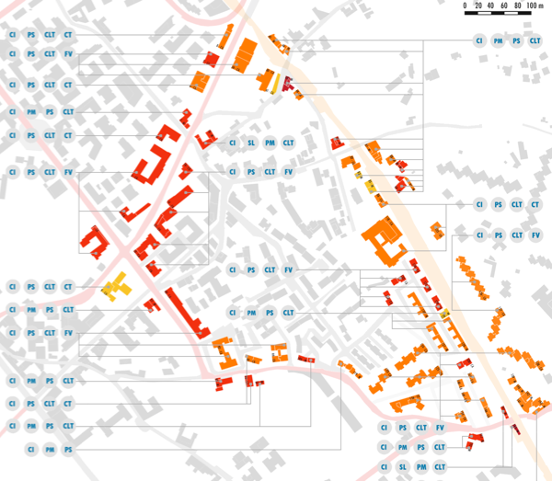
PLINIVS tools – simulation-based resilient land-use planning (Vesuvius case)
accessibility
Resilient urban planning in Ercolano based on vulnerability and impact scenario analyses.
buildings improvement

Slide 9
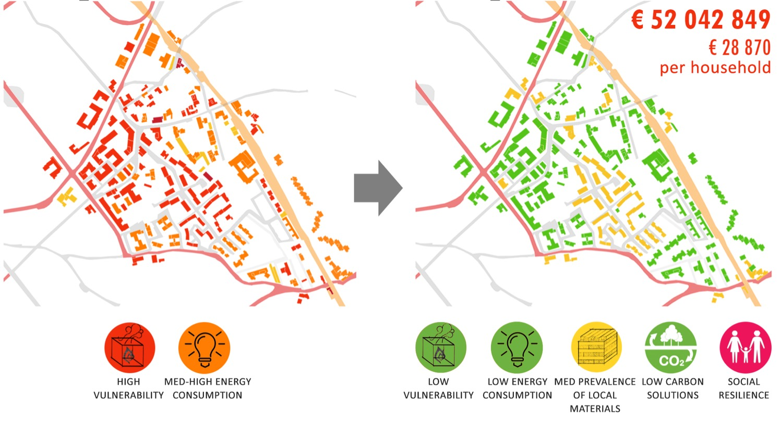
PLINIVS tools – simulation-based resilient land-use planning (Vesuvius case)
Cost-benefit and multicriteria assessment of alternative resilience options

Slide 10
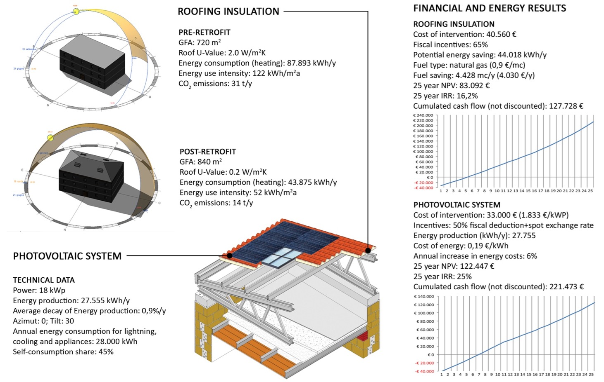
PLINIVS tools – simulation-based resilient land-use planning (Vesuvius case)
Coupling volcanic risk mitigation and energy efficiency. Study of integrated tax incentives for volcanic mitigation and climate change adaptation (Poggiomarino Building Code).

Slide 11
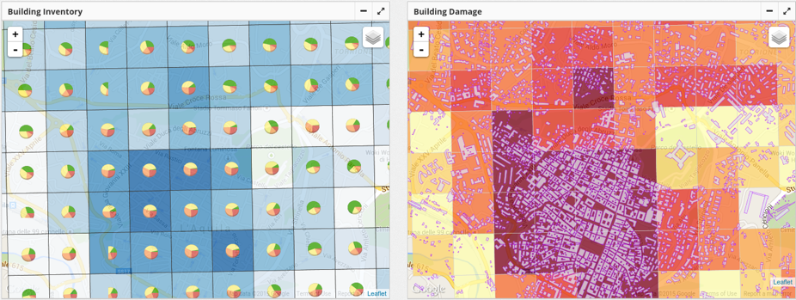
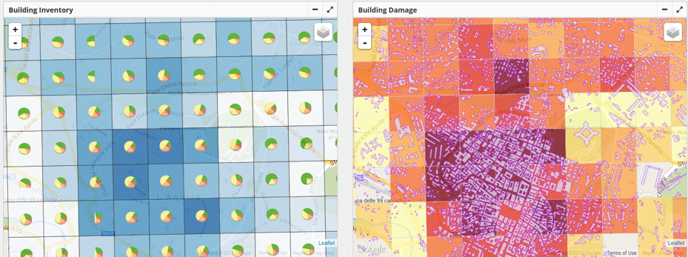
PLINIVS tools – Seismic impact simulation (L’Aquila case)
EVENT DATA: SHAKEMAP 2 'grid_xyz_20090406_332', 42.33, 13.33, 8.8, 5.8
Building damage (building distribution and Impact) – NO MITIGATION
Building damage (building distribution and Impact) – MITIGATION
OUTPUT | NO MITIGATION | MITIGATION
CASUALTIES
Deads | 249 | 199
Injured | 734 | 519
Homeless | 10481 | 8159
BUILDINGS
Building unsafe | 2679 | 2031
Building losses | 1301 | 881
assessing mitigation options through simulations

Slide 12
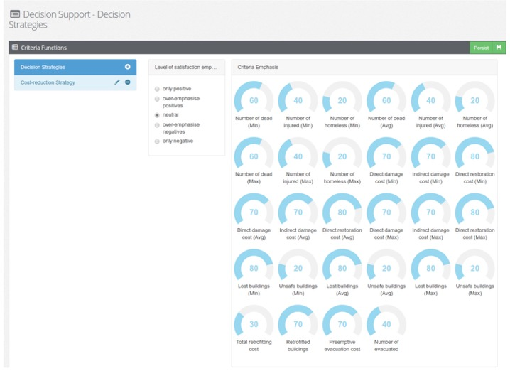
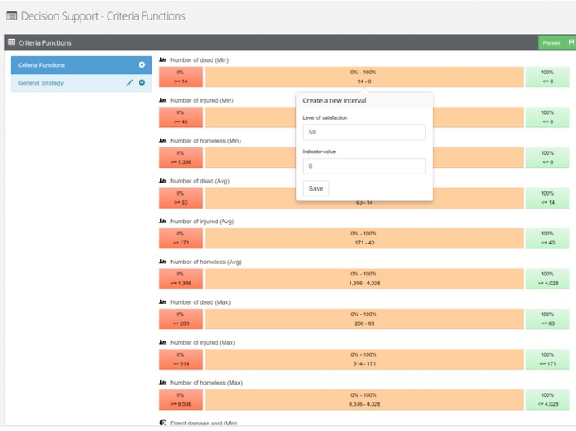
PLINIVS tools – Seismic impact simulation (L’Aquila case)
INDICATORS LIST
Damaged buildings
  Lost buildings (# of Buildings)
  Unsafe buildings (# of Buildings)
Economic cost
  Direct damage cost (Euro)
  Direct restoration cost (Euro)
  Indirect damage cost (Euro)
Casualties
  Number of dead (# of People)
  Number of homeless (# of People)
  Number of injured (# of People)
Building retrofitting
  Total retrofitting cost (Euro)
  Retrofitted buildings (# of Buildings)
Evacuation
  Preemptive evacuation cost (Euro)
  Number of evacuated (# of People)
Multi-criteria assessment of alternative mitigation options

Slide 13
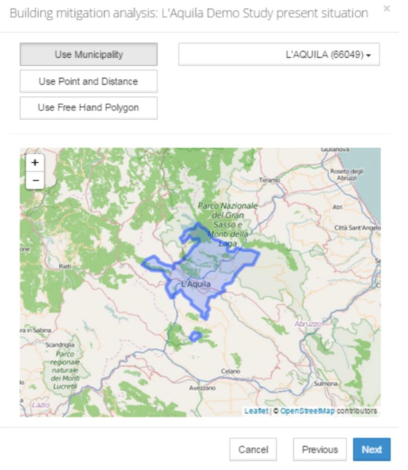
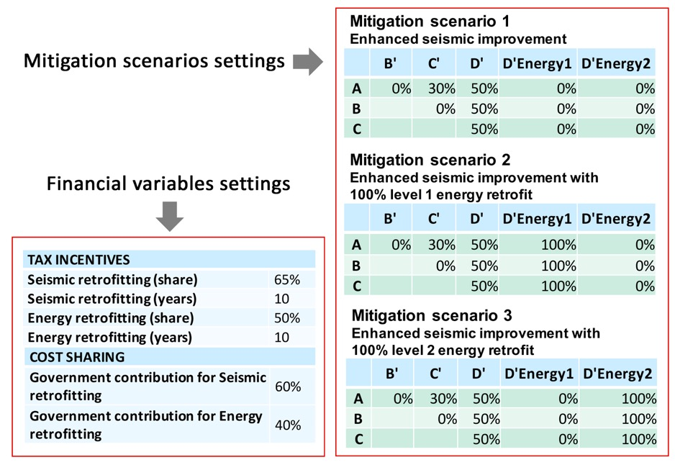
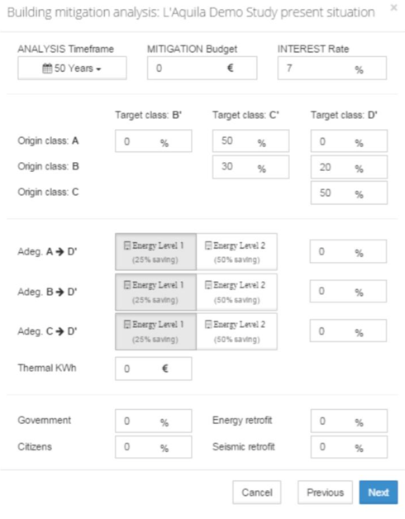
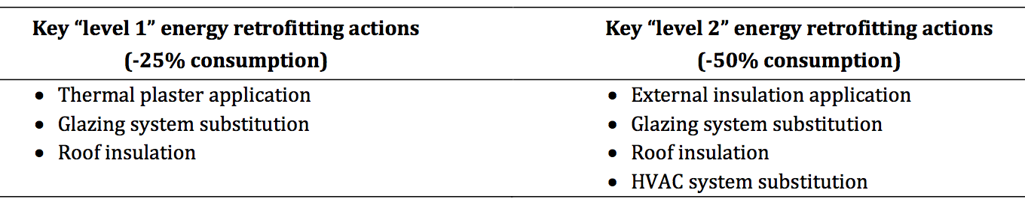
PLINIVS tools – Seismic impact simulation (L’Aquila case)
Coupling seismic risk mitigation and energy efficiency

Slide 14
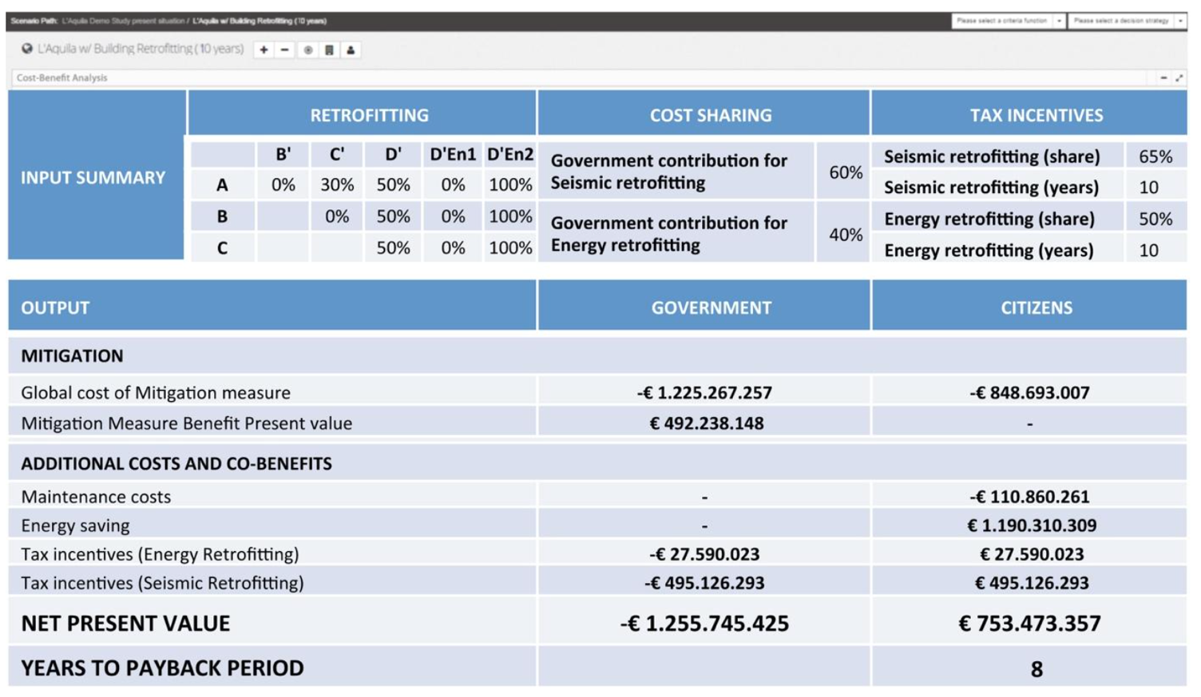
PLINIVS tools – Seismic impact simulation (L’Aquila case)
Coupling seismic risk mitigation and energy efficiency: cost-benefit analysis

Slide 15
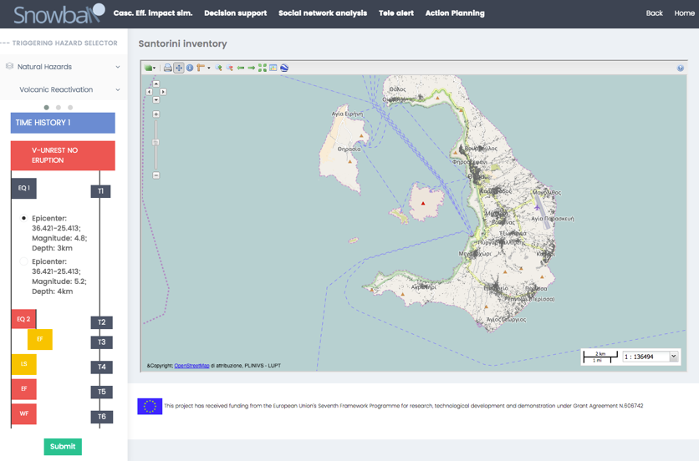
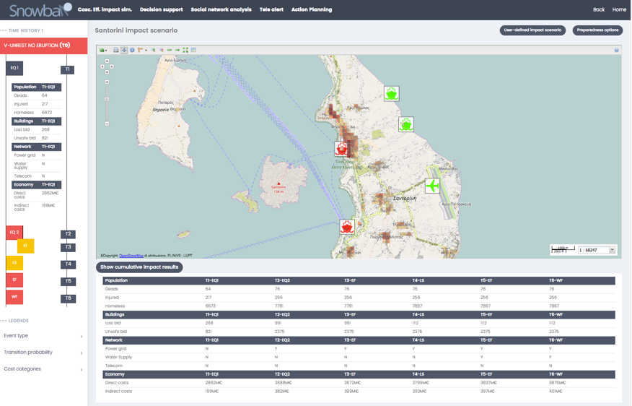
Cascading effect simulation tool – impact scenario analysis
visualising impacts
selecting c.e. scenario
The Cascading Effects Simulation Tool has been developed within EU-FP7 Snowball project, with a front end that allows the end-user to easily navigate the impact scenarios produced by the simulation service.
Once selected the time histories to be analysed, the impact on multiple elements at risk (people, buildings, critical infrastructures, service networks, economy) can be visualised as a geo-referenced map and table for each timestamp along the time history, taking into account the cumulative damage due to the sequence of events and the effect of decision making choices.

Slide 16
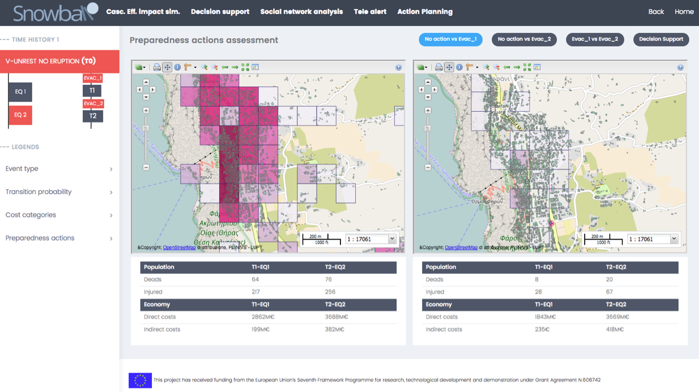
Cascading effect simulation tool – resilience planning assessment
assessing preparedness
For each simulated impact scenario, a dedicated section allows to assess the effectiveness of alternative preparedness and resilience actions (e.g. population evacuation, buildings retrofitting), by displaying a map and table comparison for each of the preparedness options, showing the damage reduction on selected elements at risk. The options can then be further compared with the multi-criteria analysis tool.

Slide 17
PLINIVS tools – Customization of models and and tools in different contexts and scales
DATA NEEDED AT LOCAL SCALE
The customization process always needs “local counterpart” to produce reliable and actionable information, aimed both at mitigation/preparedness (e.g. land-use planning), both at response and recovery (e.g. emergency planning and post-event management).

Slide 18
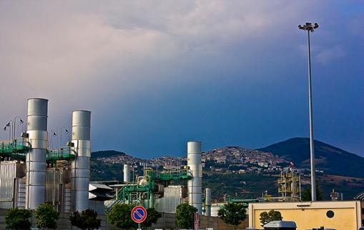
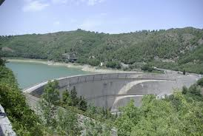
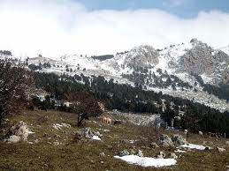
A Natech hazard scenario in Val D’Agri as opportunity for a resilience-based land use planning
A FORMING COLLABORATION BETWEEN PLINIVS CENTRE AND VAL D’AGRI RESILIENT COMMUNITY
From 100,000 to 300,000 b/d oil production and pre-processing. Largest continental oil reservoir in Europe
The Oil Center is upstream (1 km) of the Agri River and a 160 Million m³ water reservoir.
Pertusillo water dam is a 50 years old concrete wall
The main access roads to the valley are built on old bridges
70,000 people living in the proximity Agri River Valley
700 km² of Appennino Lucano National Park, with some of the most substantial biodiversity in Europe

Slide 19
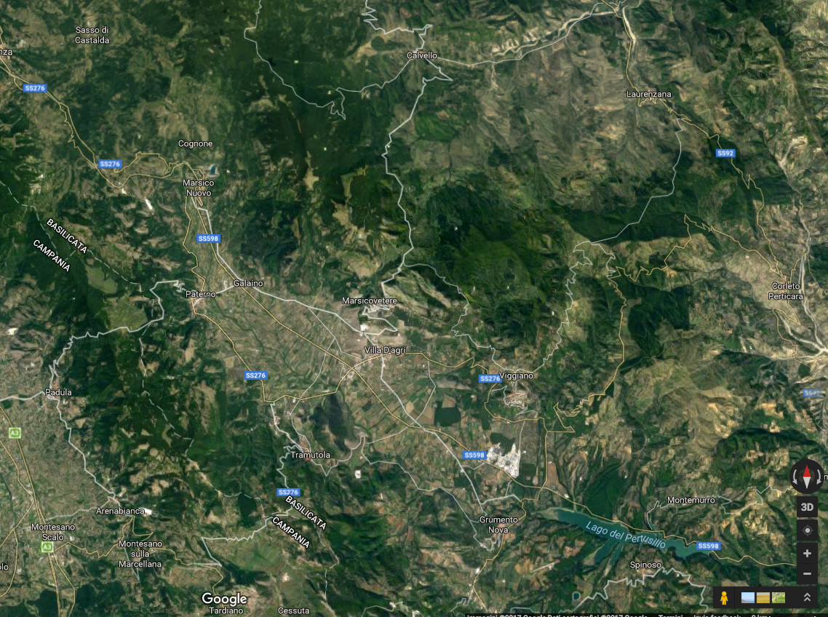
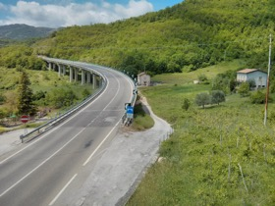
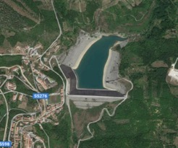
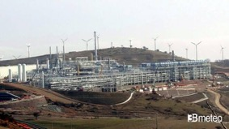
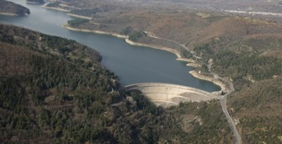









Marsico Nuovo dike
Oil centre Corleto P.
Viaduct
Villa D’Agri hospital
Viggiano
Viaduct
Petrusillo dike
Oil centre Viggiano
Grumento N. airfield

Slide 20

A Natech hazard scenario in Val D’Agri as opportunity for a resilience-based land use planning
Triggering hazard: Earthquake
High Seismic Risk Area with history of highly destructive earthquakes of magnitude 7
Potential cascading effects
Contamination of large bodies of water from oil spill
Air contamination from H₂S and other air pollutants
  Large-scale population evacuation in tent cities
  Catastrophic damages to the civil infrastructures (private and public)
  Potential damages to the water dam
  Temporary loss of main services (drinking water, electricity, transportation, etc.)
  Isolation during the first 24-48 hours due to collapse of bridges
Resilience opportunities can be:
Structural retrofitting and specialization on respiratory diseases of Villa D’Agri Hospital (in “peace time” → attractive potential beyond the local level)
Strengthening of Grumento Nova airfield (in “peace time” → (increase of tourist activities in Appennino Lucano National park)
Structural reinforcement of viaducts and water dam to mitigate cascading effects
… → networking and collaboration between researchers and local stakeholders is the key

Slide 21
CONCLUSIONS
Land-use planning and resilience building can take advantage from simulation scenario analysis approaches, which allow the understanding of physical and economic impacts due to natural, technological or natech hazards.
Most advanced tools and services allows a customization process based on specific needs of stakeholders and communities, which highlights the opportunities for action emerging at local level.
Alternative land-use planning and disaster risk reduction options need to be assessed through robust multi-criteria and cost-benefit analyses to support decision-making process and funding programming.
The evaluations should emphasize the benefits of mitigation/adaptation options not only after a hazard event occur, but also in “peace time”.
Importance of the strict collaboration of all the actors (public authorities, population, science, enterprises, investors, stakeholders in general) to achieve a resilient society and actionable Disaster Risk Management and Reduction strategies.

